Slide 1
CNN
Probability of ice-ring contamination

Slide 2
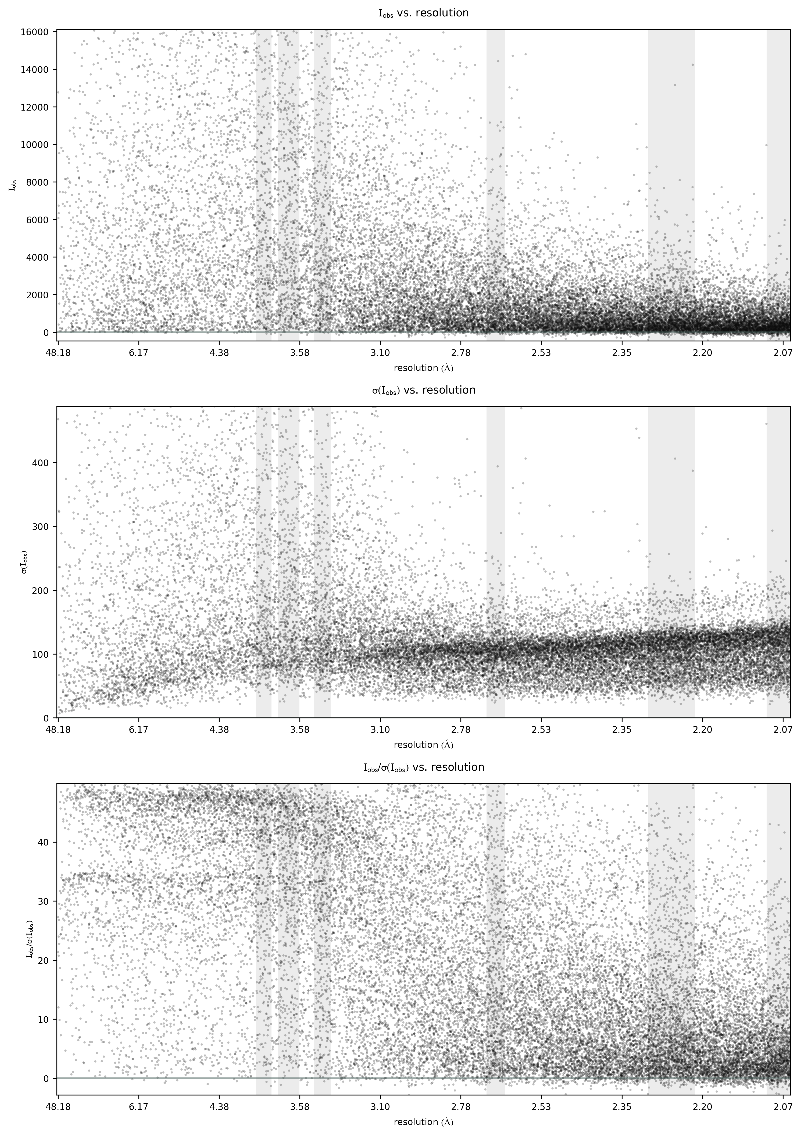

Slide 3
Metric | Test
True positive | 83
False positive | 17
True negative | 1345
False negative | 5
Accuracy | 0.985
Precision | 0.830
Recall | 0.943
Program | tp | tn | fp | fn | Accuracy | Precision | Recall
phenix.xtriage | 14/42 | 145/158 | 13 | 28 | 79.5 % | 0.52 | 0.33
CTRUNCATE | 23/42 | 88/158 | 70 | 19 | 55.5 % | 0.25 | 0.55
Auspex | 25/42 | 143/157 | 14 | 17 | 84.5 % | 0.64 | 0.60
Helcaraxe | 37/42 | 140/157 | 17 | 5 | 89.5 % | 0.69 | 0.88

Slide 4
I_obs vs F_obs
4251 Images
8159 Images

Slide 5
Current state
Helcaraxe: CNN model which is capable of detecting ice ring characteristics in single image. (Image is classified either as ice ring or not. In addition a probability (certainty of classification) is given)

Slide 6
Outlook
If possible I want to also rate the size of the ice ring through a score. This could be done either statisticly or through ML
→ I need a way to determine the size of an ice ring.
A decider model should be built. It takes the Position, the Probalility and optionally the size for each image of a diffraction data set and returns a probability of ice ring contamination.

Slide 7
Ice ring score
Ice-finder score: S = N^{1/2}(〈I_{obs}〉s⁻¹ − f)]
I am looking to quantify the deviation of the ice ring image from the „normal“ image.

Slide 8
Decider model
Position
CNN
Decider Model
Probability
.mtz
Score/ Probability
Probability
Position

Slide 9



.mtz
$$I_{obs}$$
$$F_{obs}$$
$$Resolution$$
Dataset
Training /Validation set
Model Training
Model Evaluation
Deployment
Labeling
Test set
2D-histogram

